Slide 1
Catch me if you can
Information security project
AMARATHUNGA A.A.S.R.
IT15028938
RASHAN PASINDU K.A.
IT16006126
JAYAKODI S.M.P.V.
IT16522466

Slide 2
Scenario
There is a server breach happend at SLIIT. The person who breach into the server room left a FLAG accidently, which can identify him. As a cyber expert it's your duty to find that FLAG and identify the anonymous person. In order to do that you have to go through a process.

Slide 3
Source code analysis
Here main focus is analyzing the source code and get the decode text.
Then the player has to figure out what kind of encoding type it is and get the correct flag to login to the system.

Slide 4
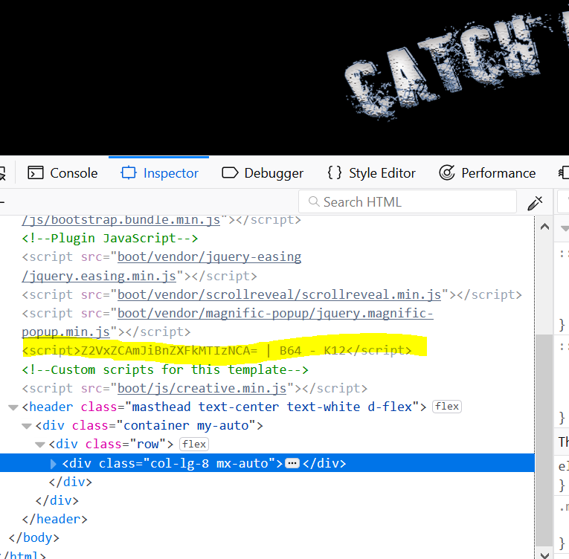

Slide 5
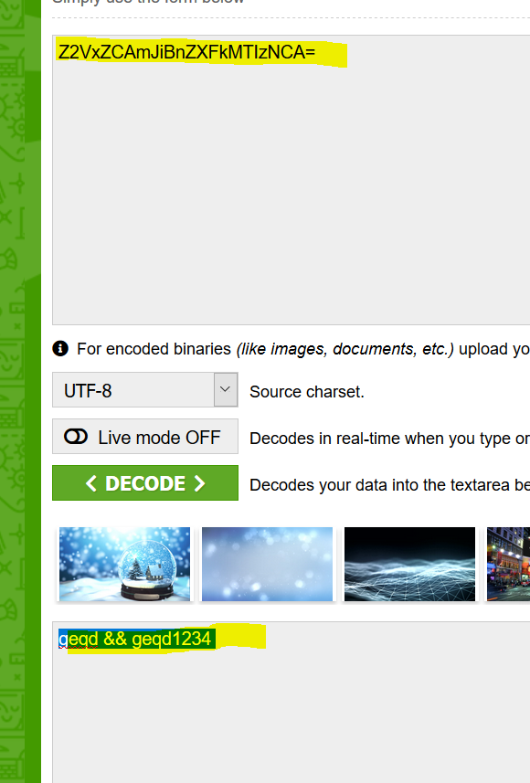

Slide 6
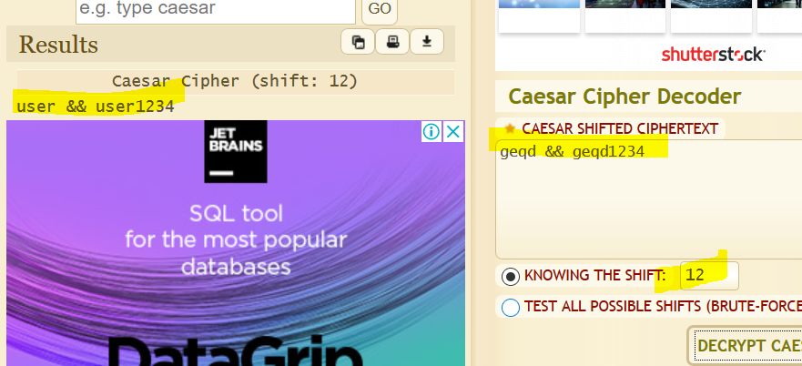

Slide 7
Steganography
A text is hidden under the downloadable picture. Player has to get the text and decode that text in order the get the correct flag.

Slide 8
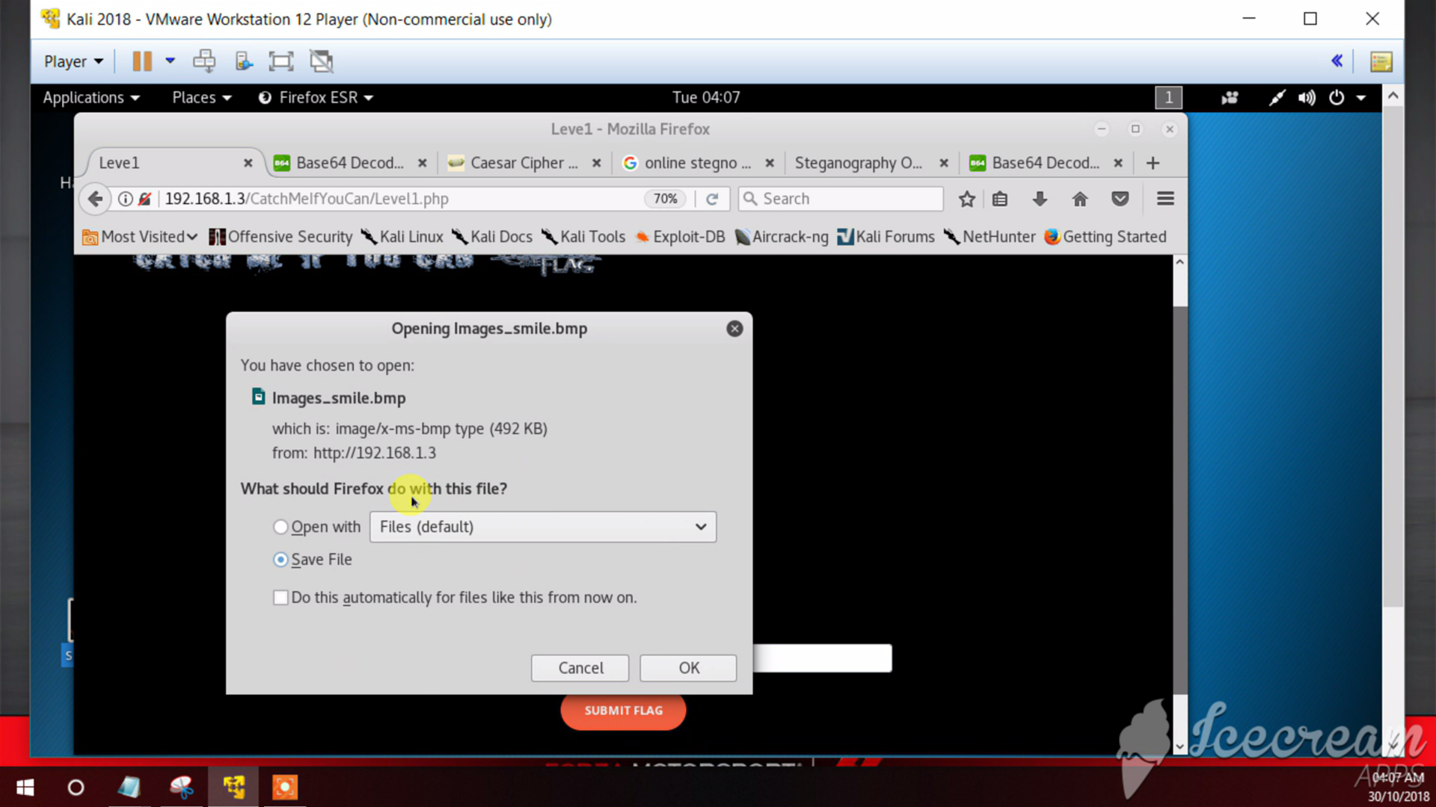

Slide 9
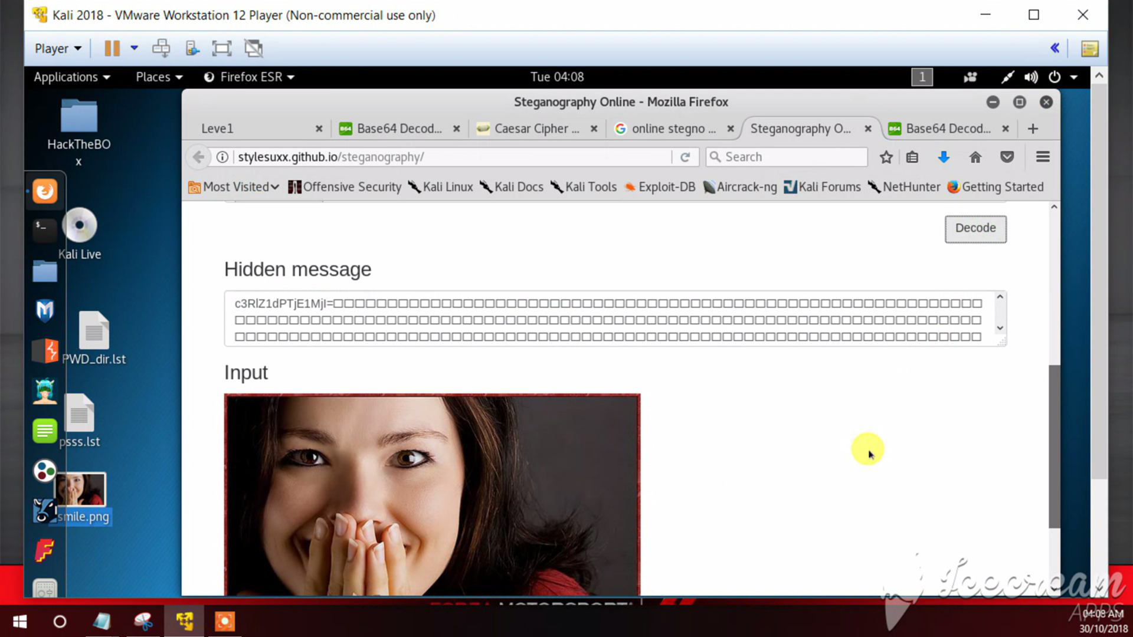

Slide 10
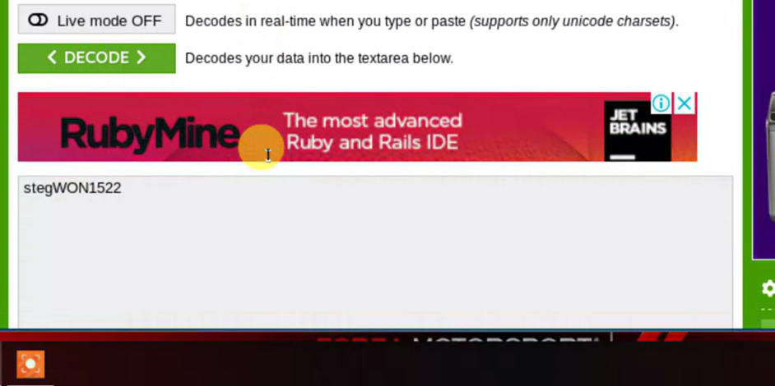

Slide 11
Morse code
Player has to download the attached text file and identify the pattern.

Slide 12
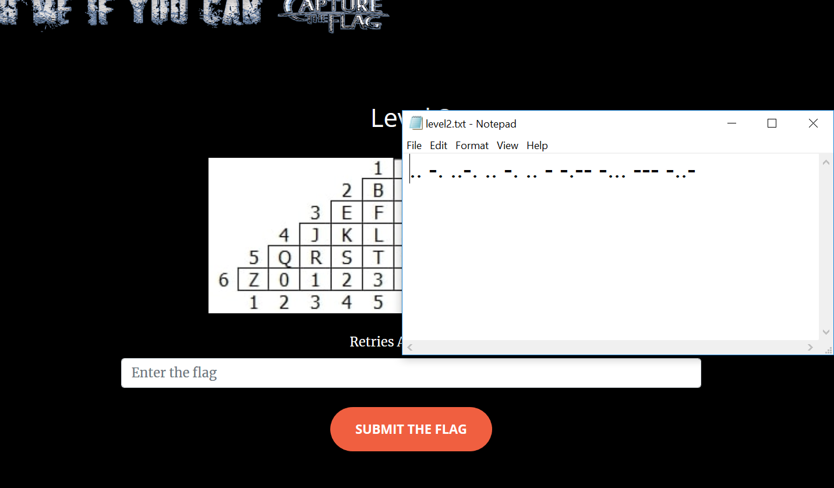

Slide 13
Linear feedback shift registers
In this level the player must have knowledge about how LFSR works. Player has to draw and get the output of the LFSR.

Slide 14
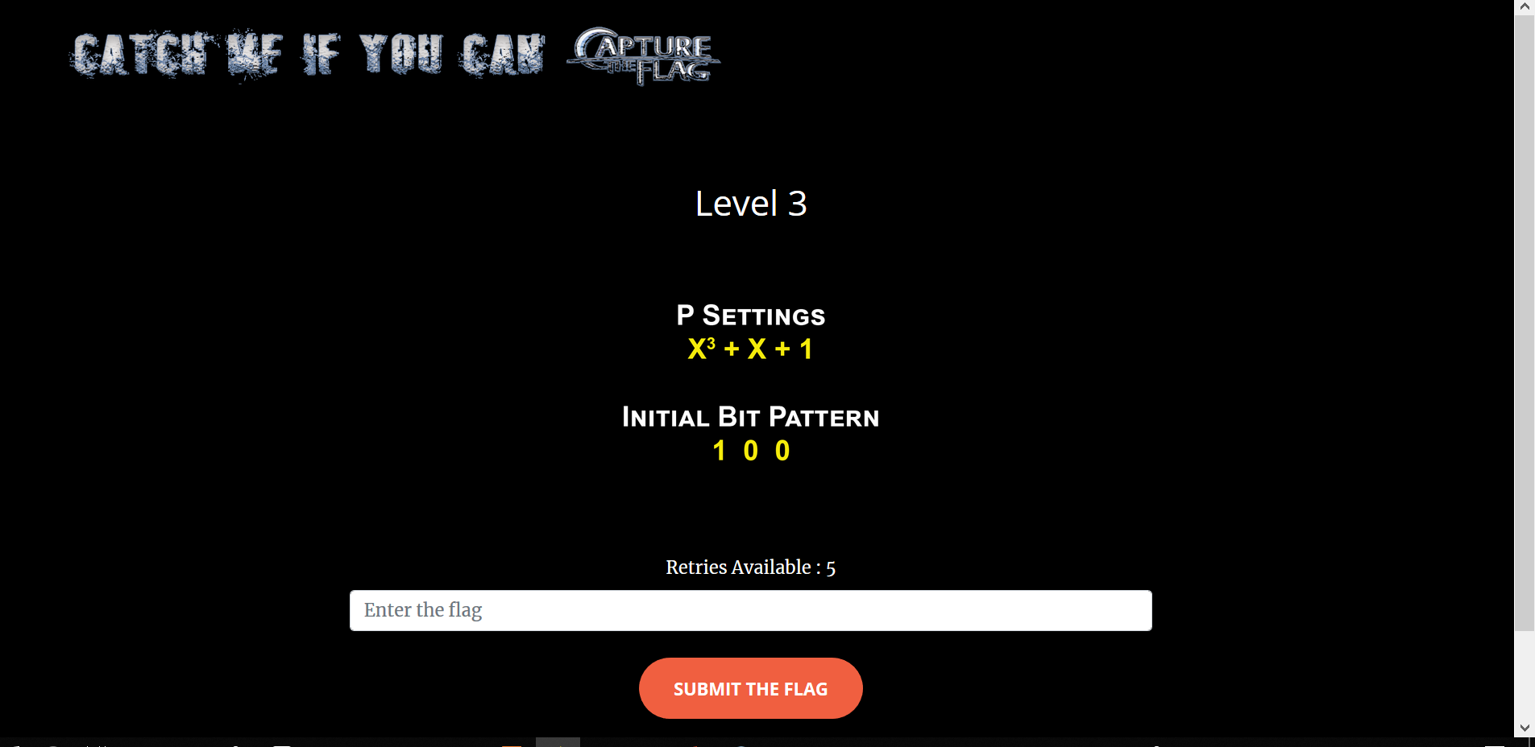

Slide 15
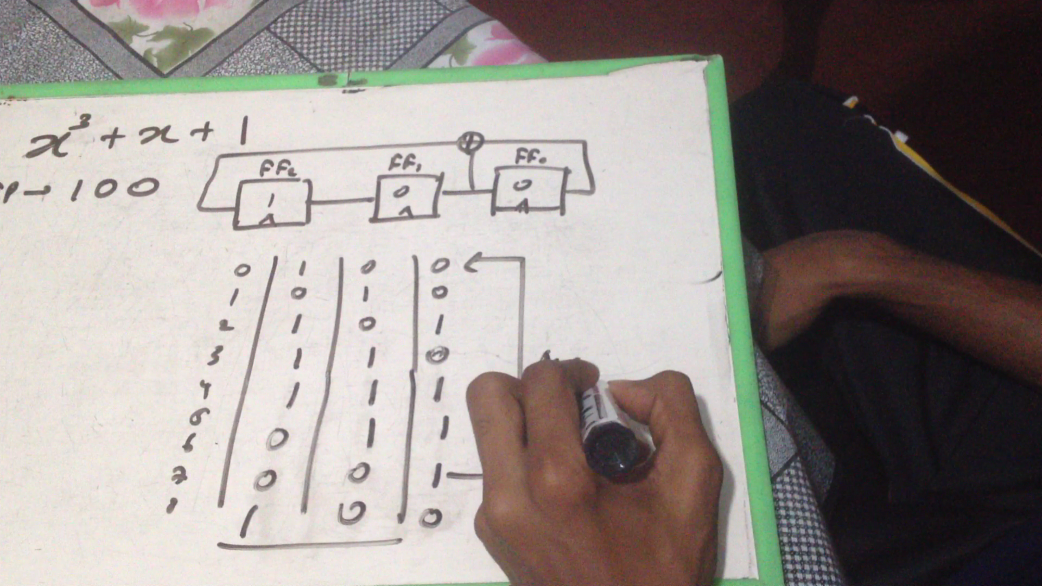

Slide 16
Dumpster diving
This comes under digital forensics. Downloadable dump is given. Player has to find the level key hidden in the dump using a tool. : Autopsy

Slide 17
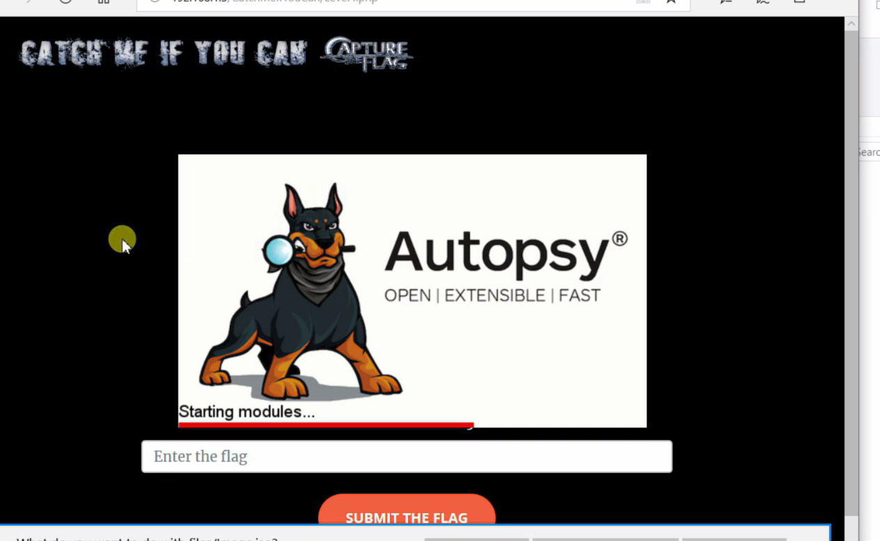

Slide 18
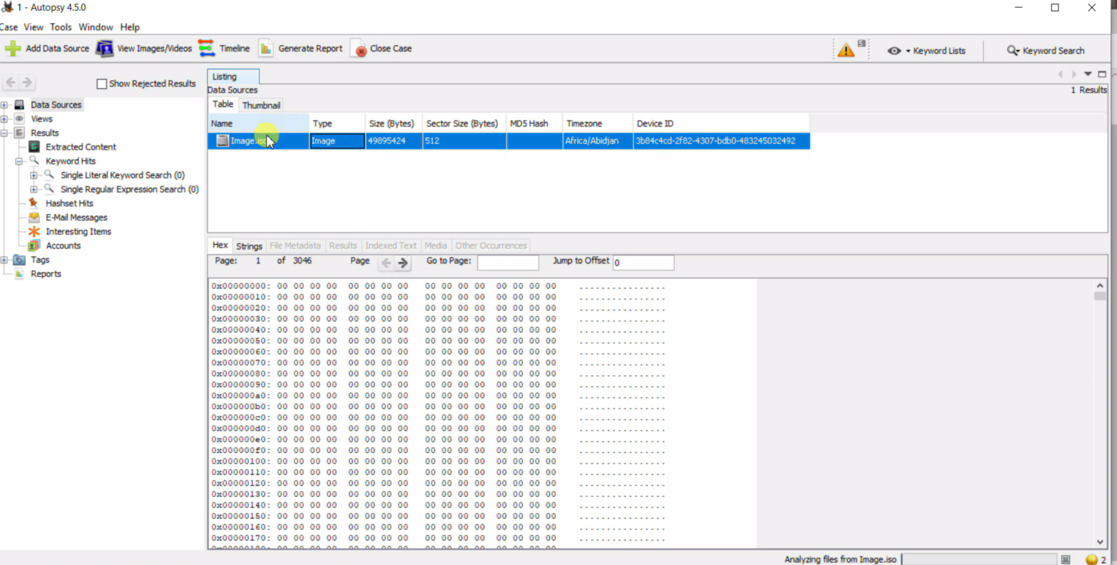

Slide 19
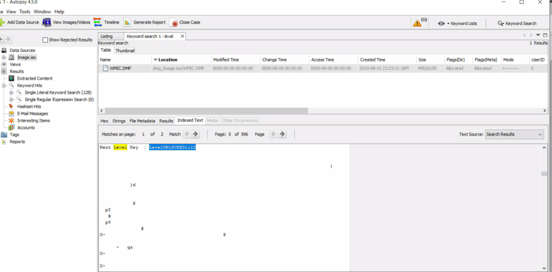

Slide 20
SQL Injection
In this level the player must have basic knowledge about SQL injection. Only way to pass this level is using SQL injection.

Slide 21
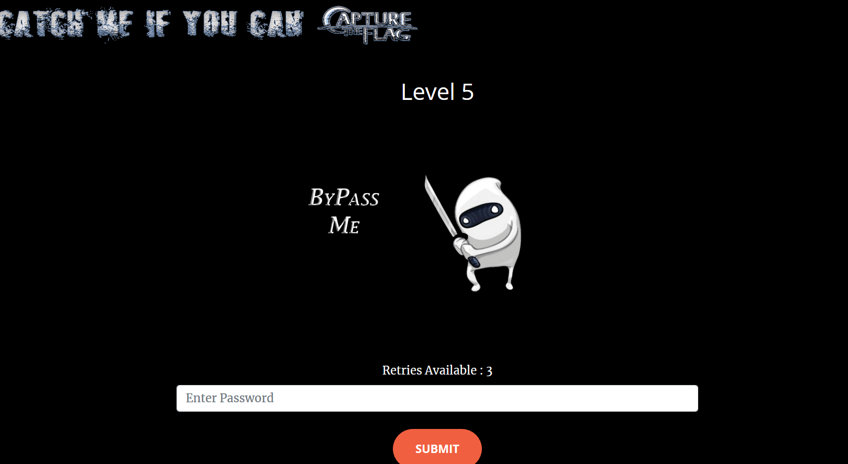

Slide 22
TINY encryption
Here a downloadable file is given. The data in that file is encrypted using tiny encryption algorithm. Player can decrypt it using a online tool.
Player should know that it is encrypted using tiny encryption using the given clue.

Slide 23
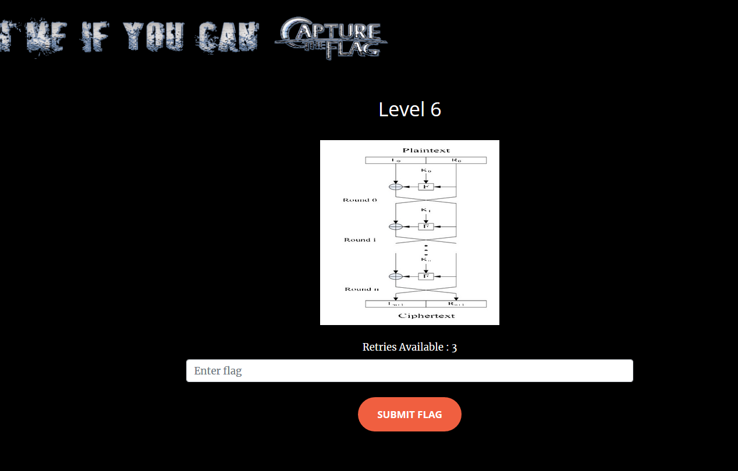

Slide 24
Cookie based
Player must get the value of the custom generated cookie and submit it as a flag in order to go to the next level. Player can use tools like Burp suite for this level.

Slide 25
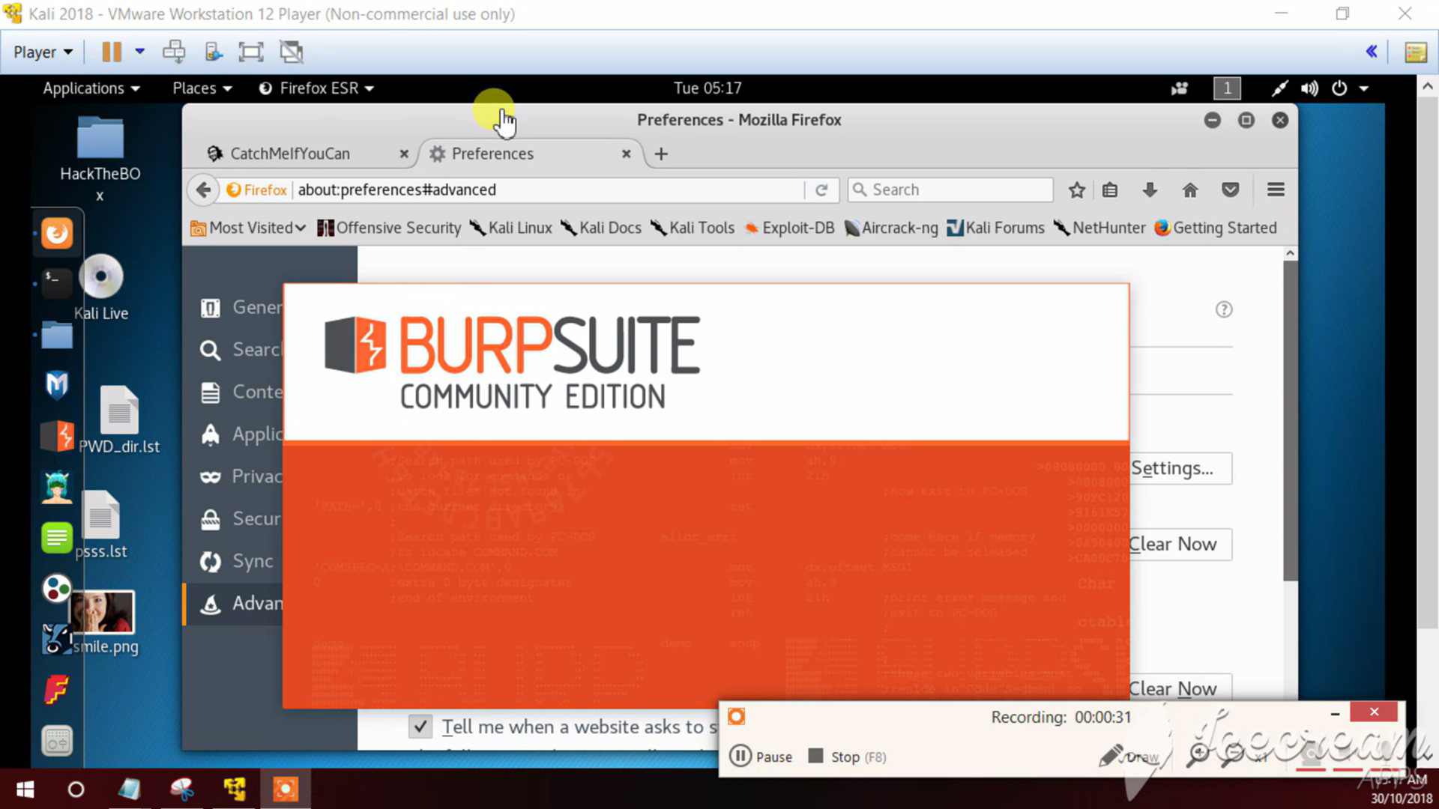

Slide 26
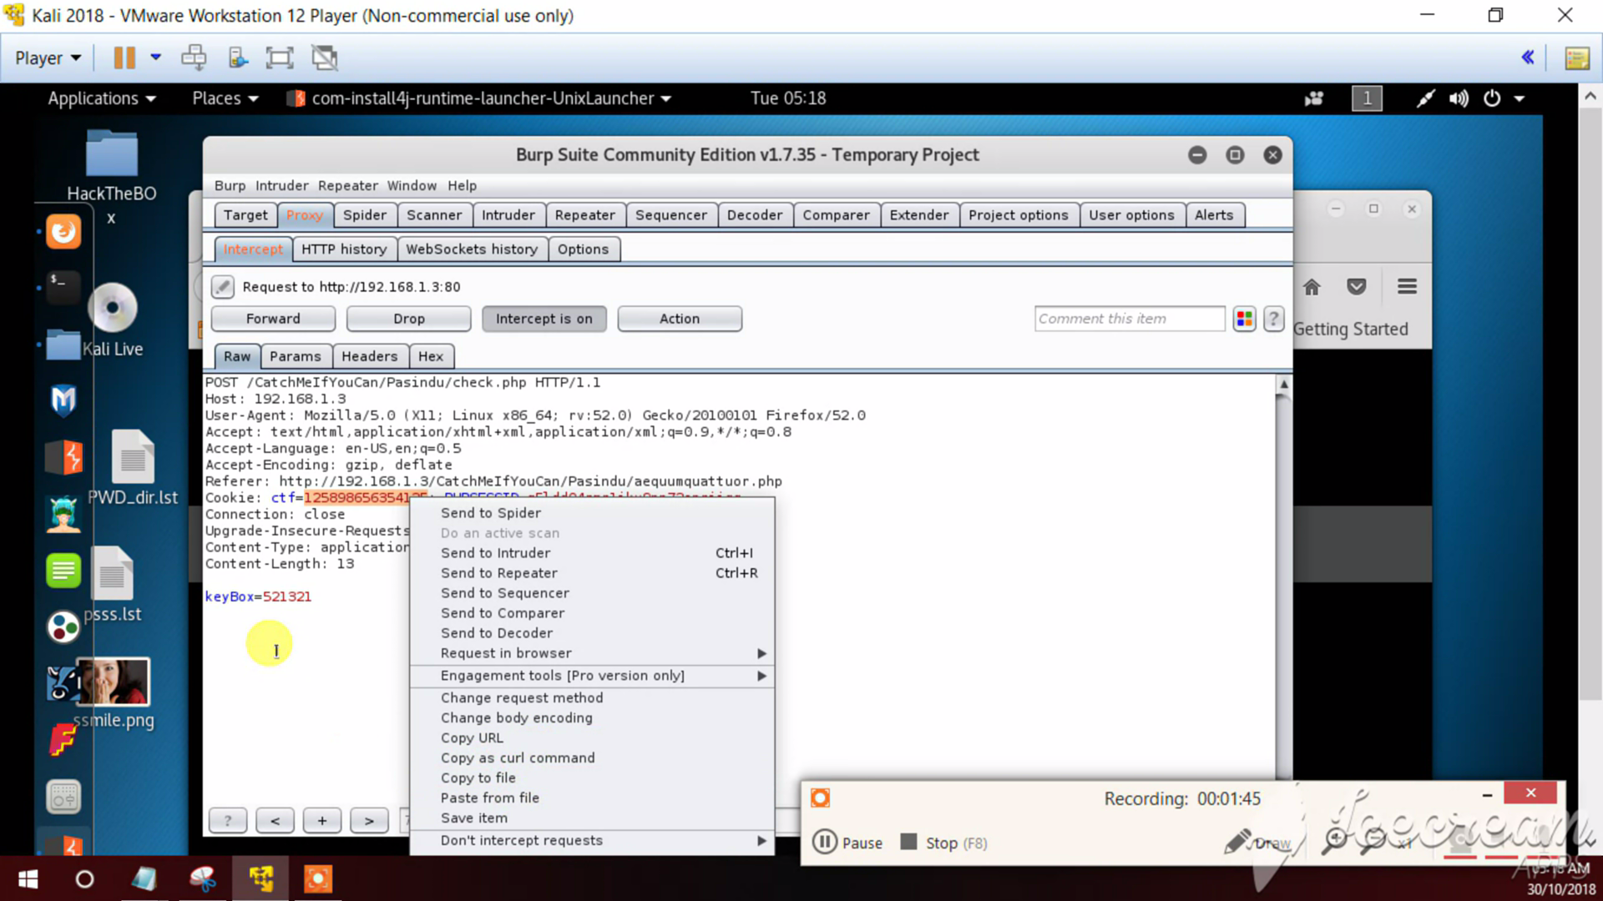

Slide 27
AES Encryption
Payer should find the hidden encrypted cipher text and the key.
Use hints to navigate through the 1GB of encrypted cipher text and find the flag by decrypting it.

Slide 28
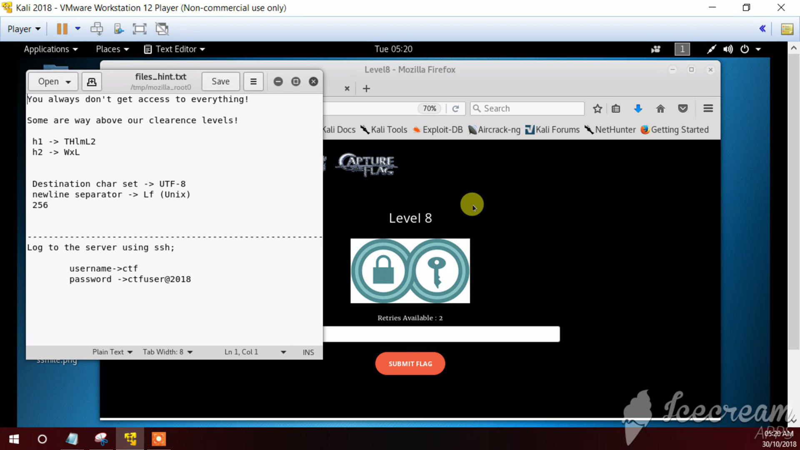

Slide 29
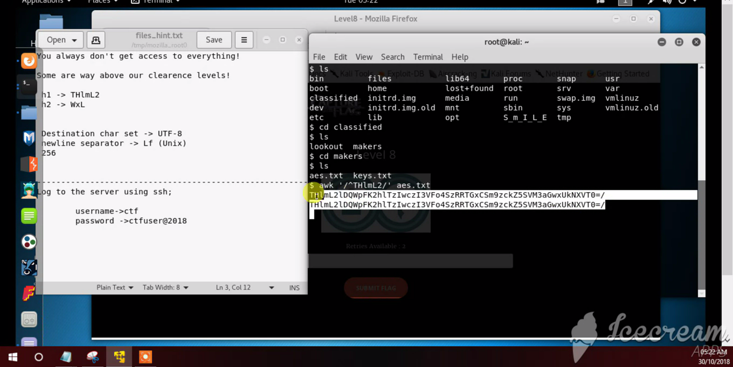

Slide 30
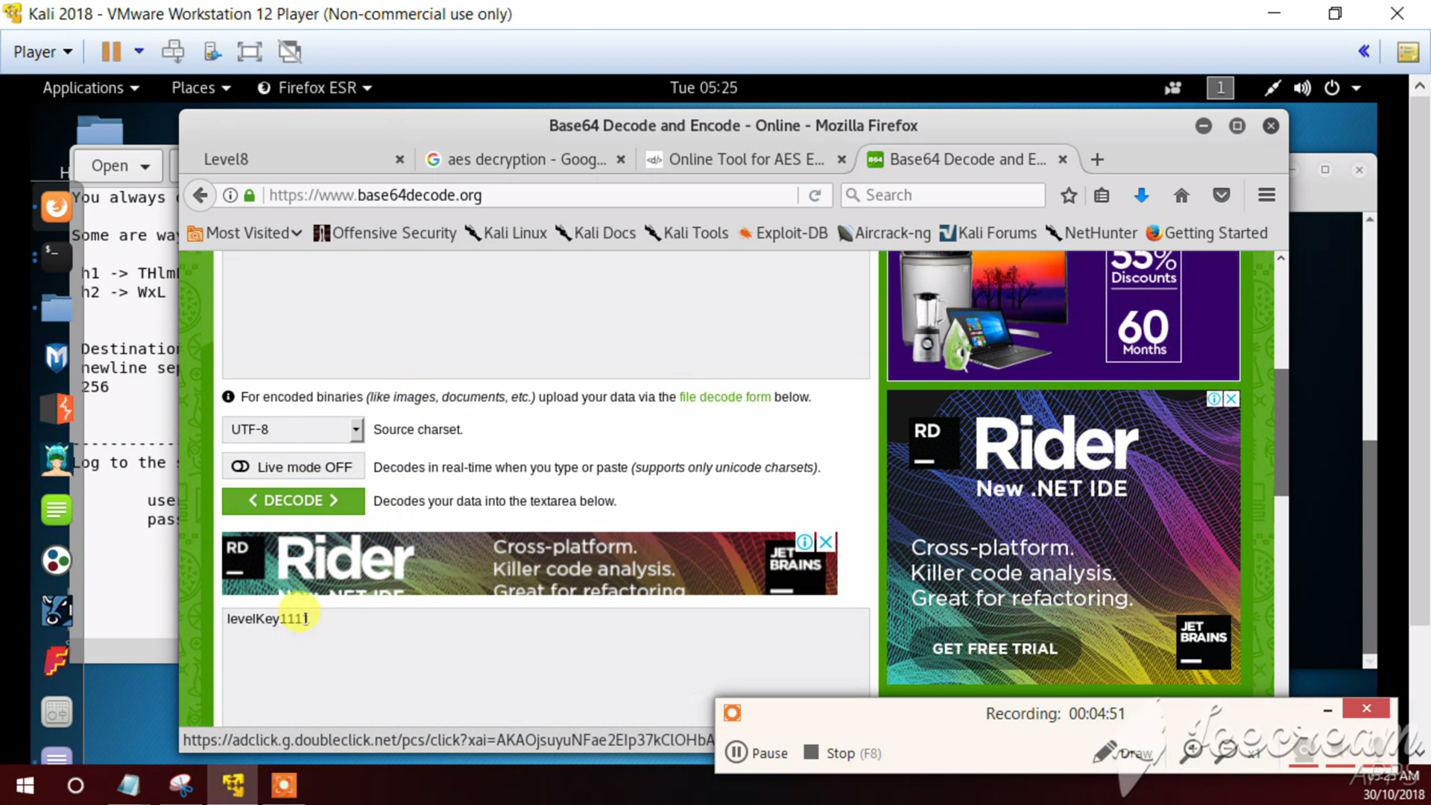

Slide 31
Packet and protocol analysis
Using a given pcap file and with the help Wireshark tool player should identify what type of an network attack it is.

Slide 32
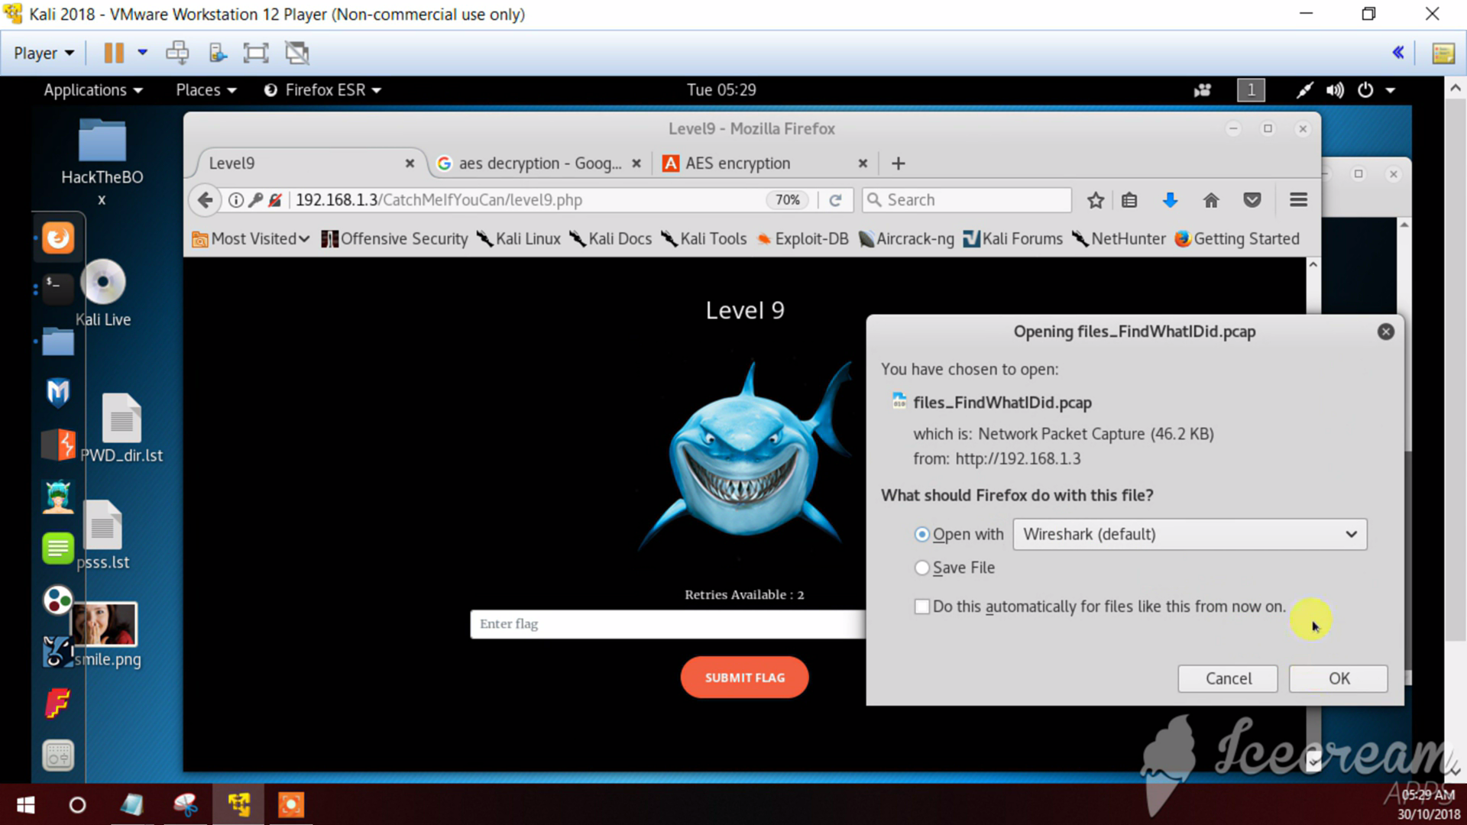

Slide 33
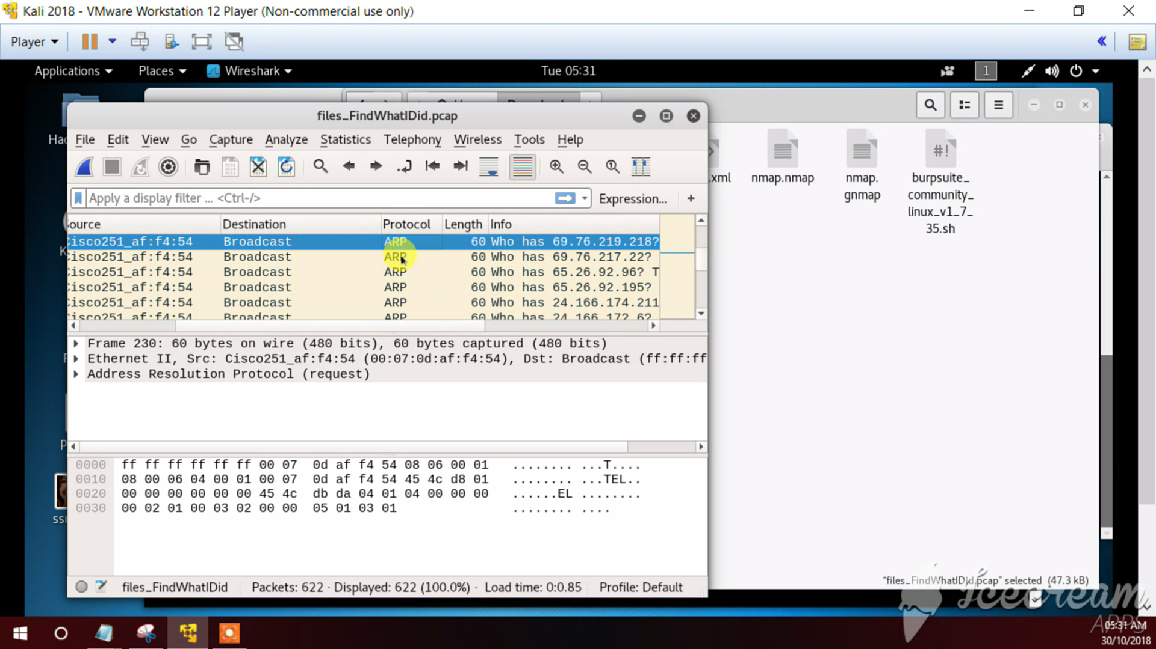

Slide 34
Bruteforce attack
Player should do a bruteforce attack and get the flag.
A password dictionary is given.

Slide 35
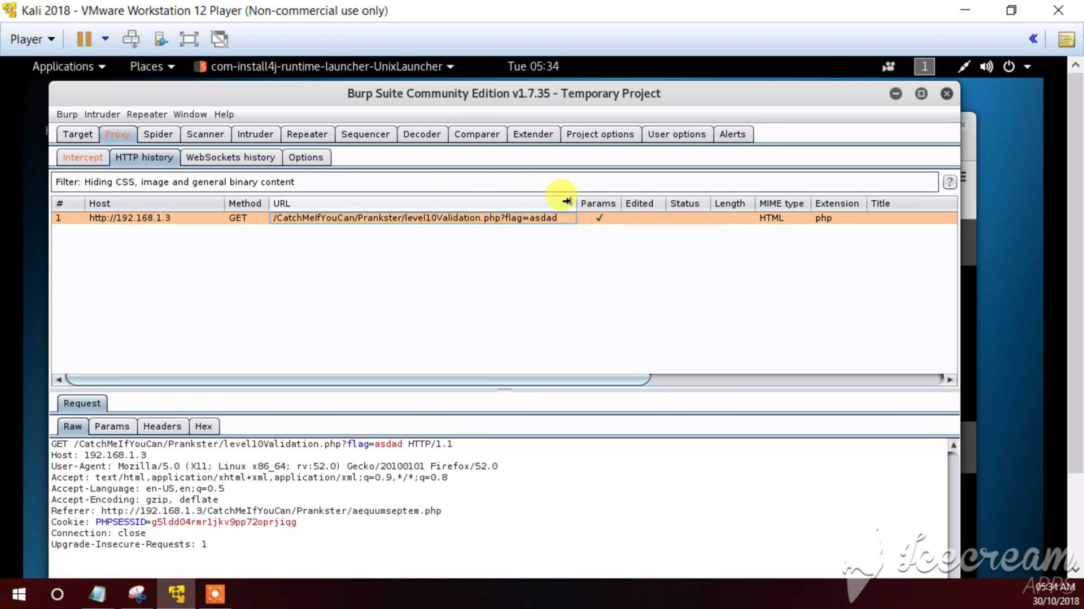

Slide 36
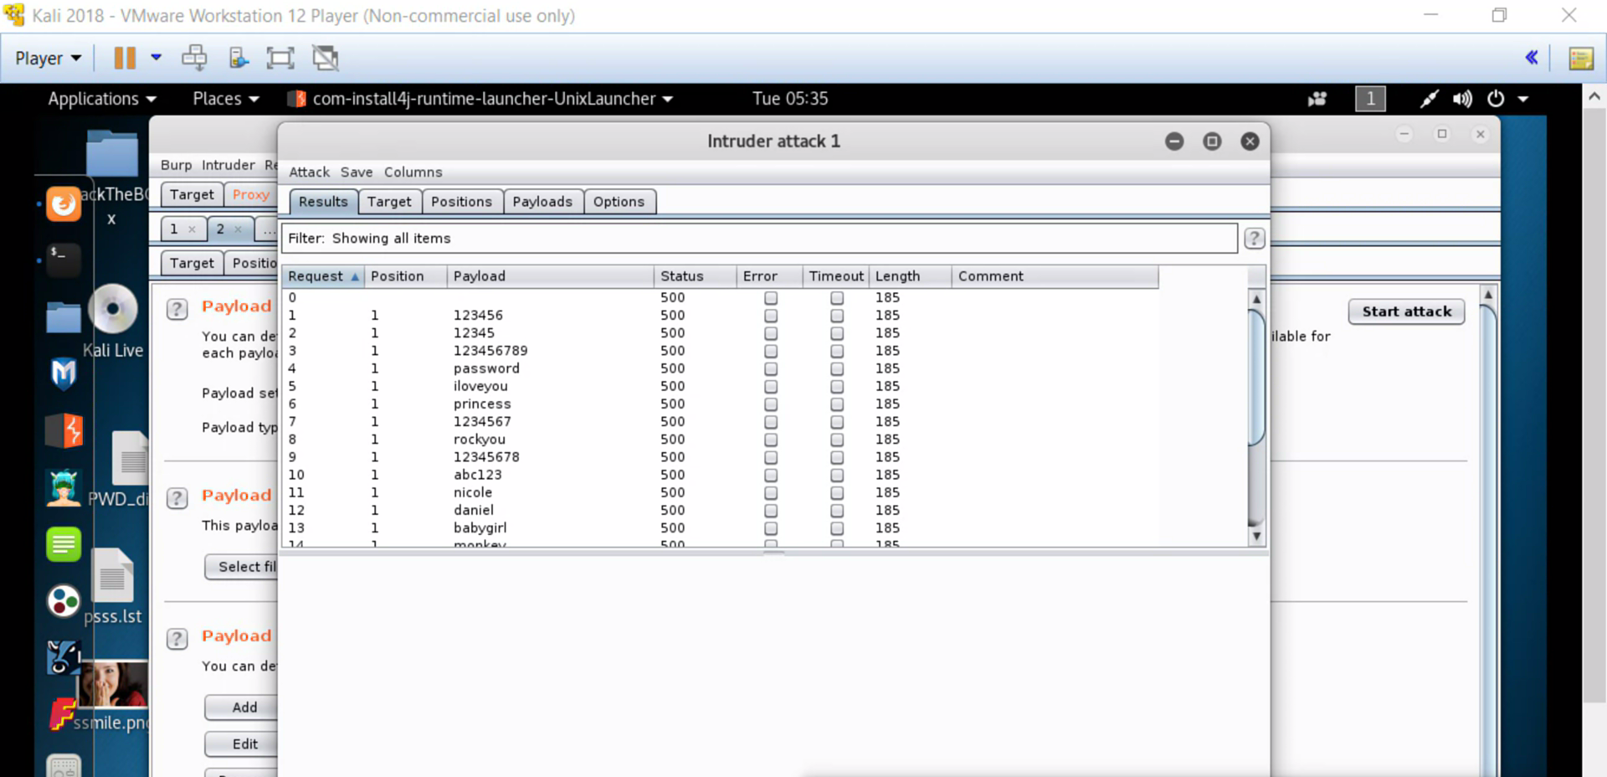

Slide 37
results
After submitting the final flag the player (the cyber expert) identifies the person who did the server breach!

Slide 38


Slide 39
ENJOY!

